Slide 1
Hydrological Status and Outlook System (HydroSOS)
IDMP Meeting

Slide 2
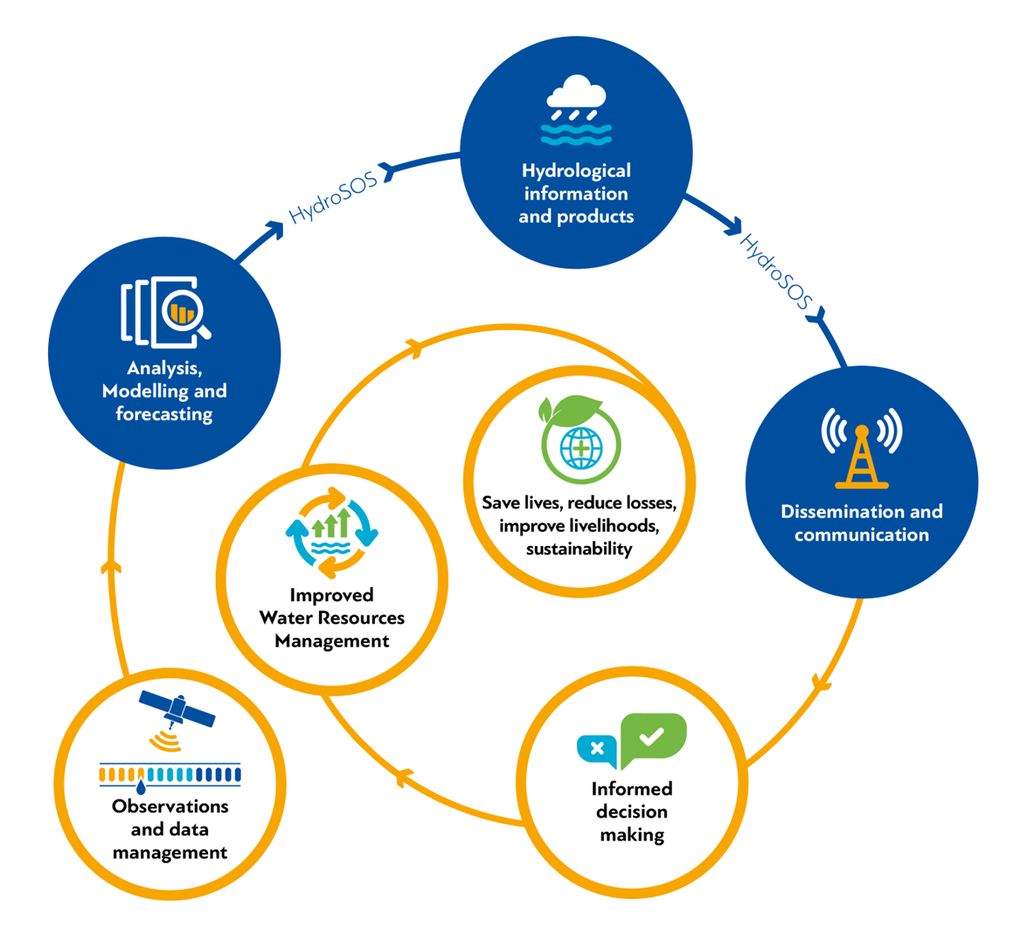
What is HydroSOS?
HydroSOS is the link between monitoring and decision making
 | 2

Slide 3
What will HydroSOS provide?
 | 3
Notes:
HydroSOS will provide an overview of the current hydrological status, including groundwater, river flow, soil moisture and snow variables
an appraisal of where the current status is significantly different from “normal”, which will indicate drought and flood susceptibility
And an assessment of whether this is likely to get better or worse over the coming weeks and months

Slide 4
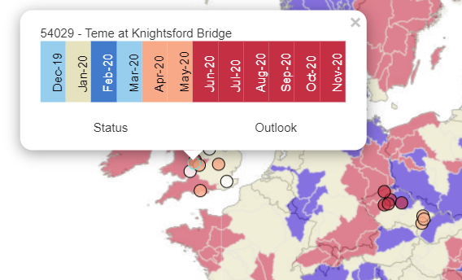
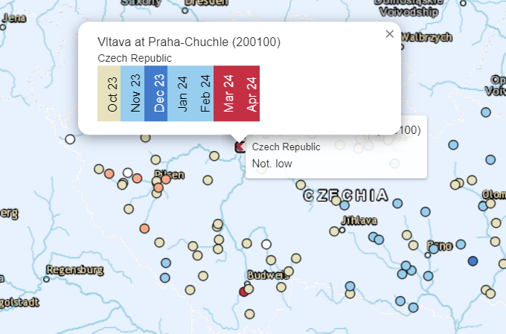
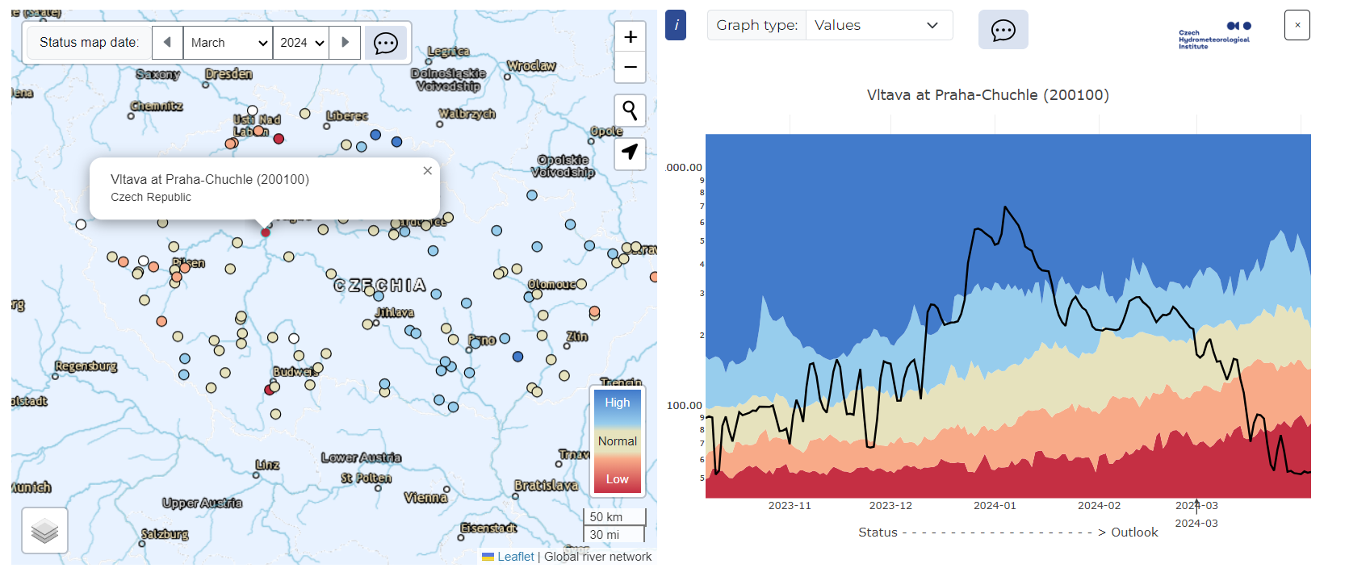
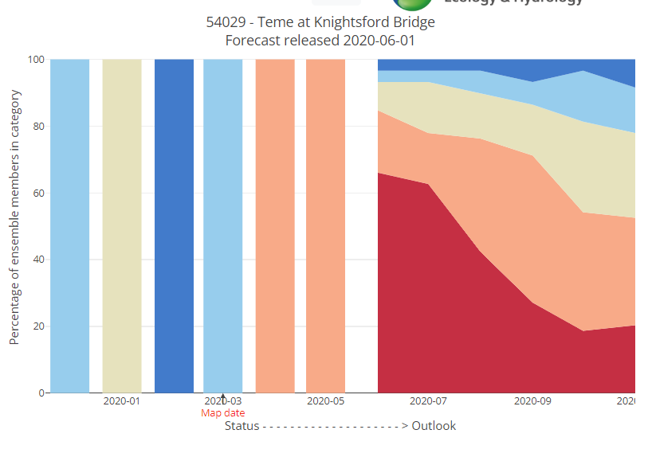
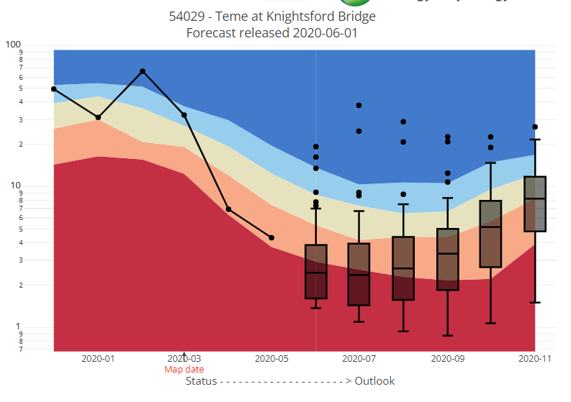
Status Example (Czechia)
Outlooks Example (UK)
Notes:
The technical team have produced an R script that can perform these calculations at the click of a button. We are working on developing this in other programming languages, with the aim of providing a toolkit that HydroSOS partners can use to calculate status, and in future outlooks operationally
Merge slide 6 and 7.

Slide 5
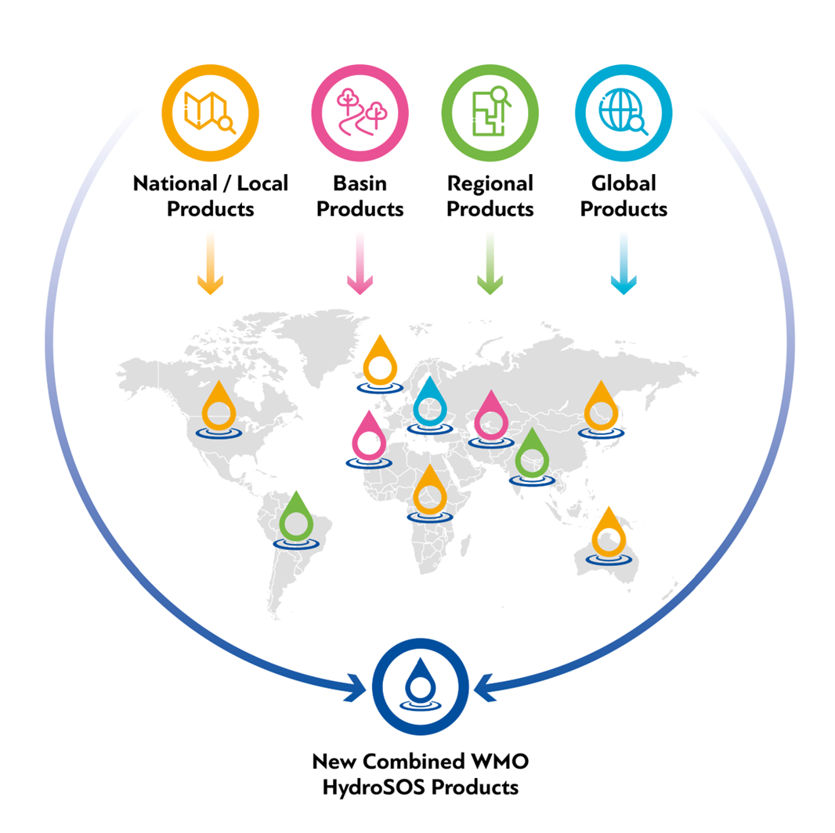
How does HydroSOS work?
A disconnect between top-down and bottom-up approaches is an impediment to action
HydroSOS will help enhance services and support decisions at national, basin, regional and global scales
 | 5

Slide 6
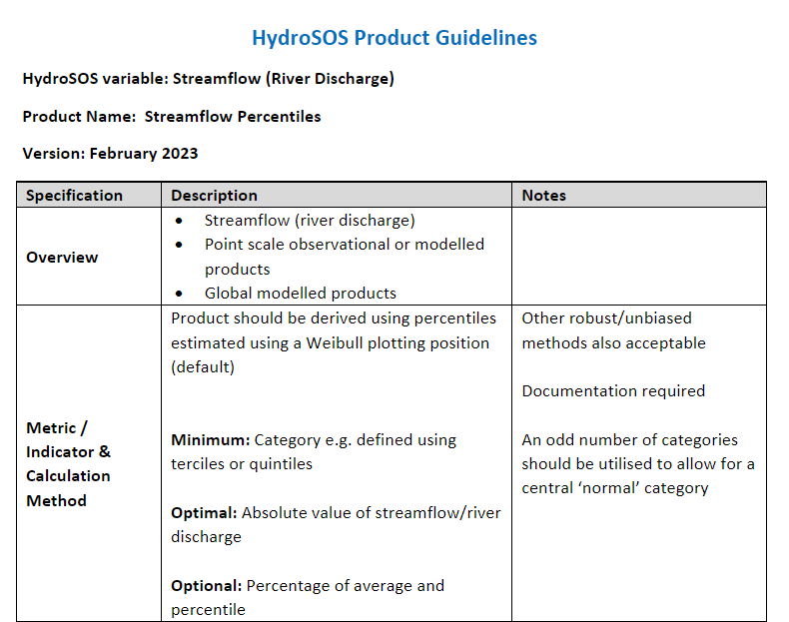
Key HydroSOS Variables
Snow Water Equivalent
5 Key starting variables
Runoff
Soil Moisture
Streamflow (Point River Discharge)
Groundwater
 | 6
Notes:
These product guidelines have been produced for five key starting variables, snow water equivalent, soil moisture, groundwater, runoff and streamflow.

Slide 7
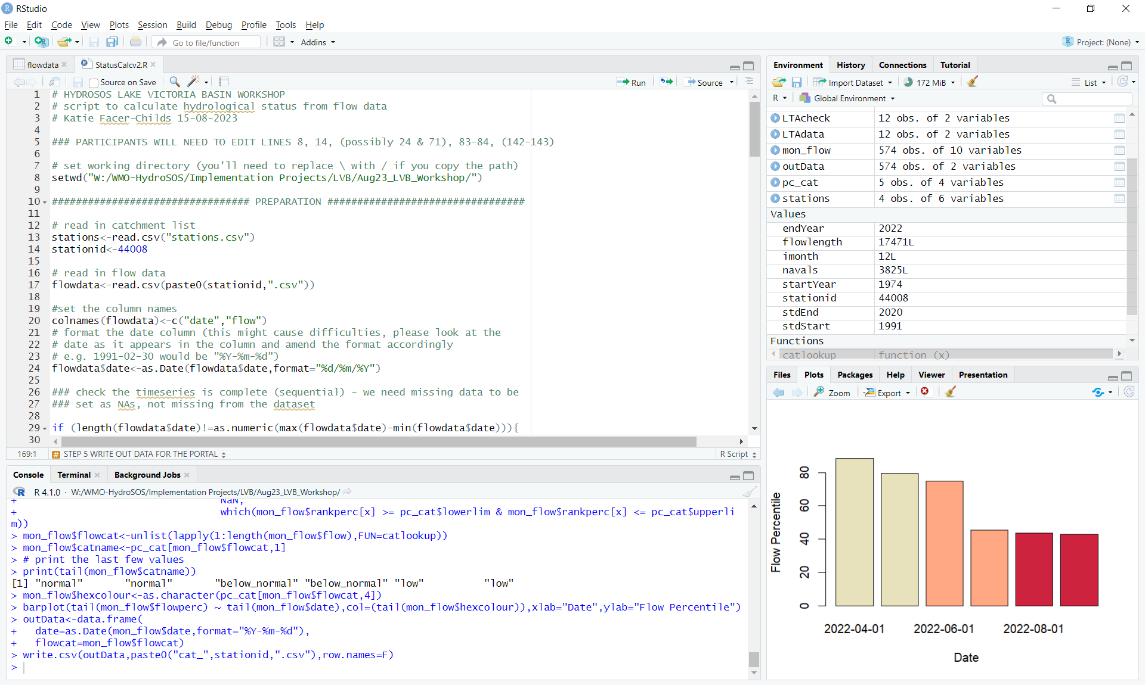
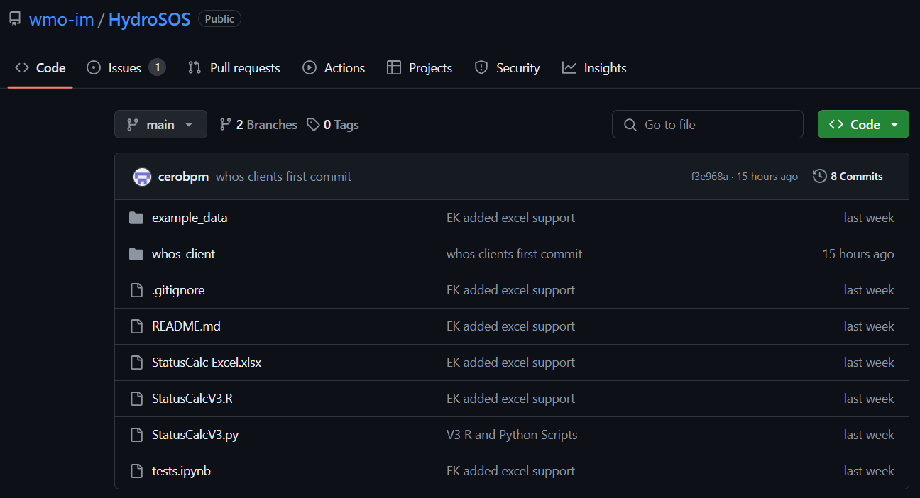
On going work: Methods Guidance
Calculating HydroSOS Products – Status R, Python and Excel codes
WMO HydroSOS GitHub Repository
Status R Code
Notes:
The technical team have produced an R script that can perform these calculations at the click of a button. We are working on developing this in other programming languages, with the aim of providing a toolkit that HydroSOS partners can use to calculate status, and in future outlooks operationally

Slide 8
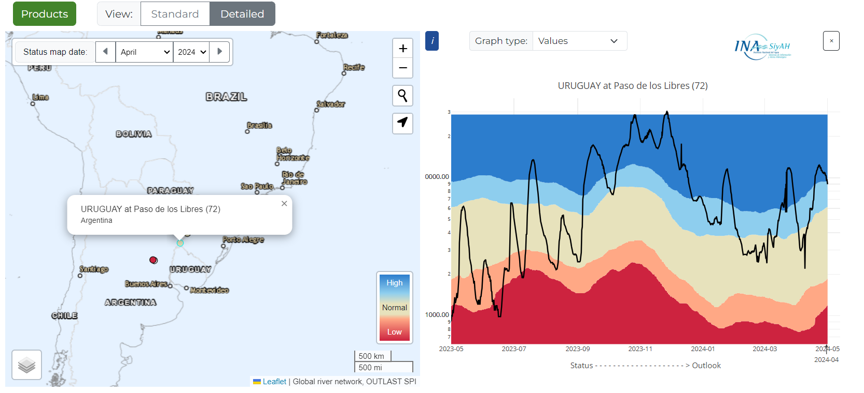
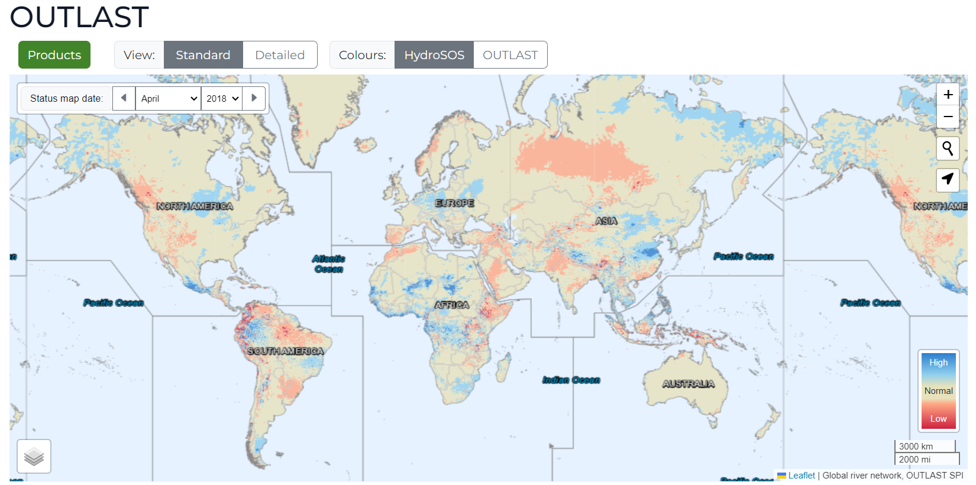
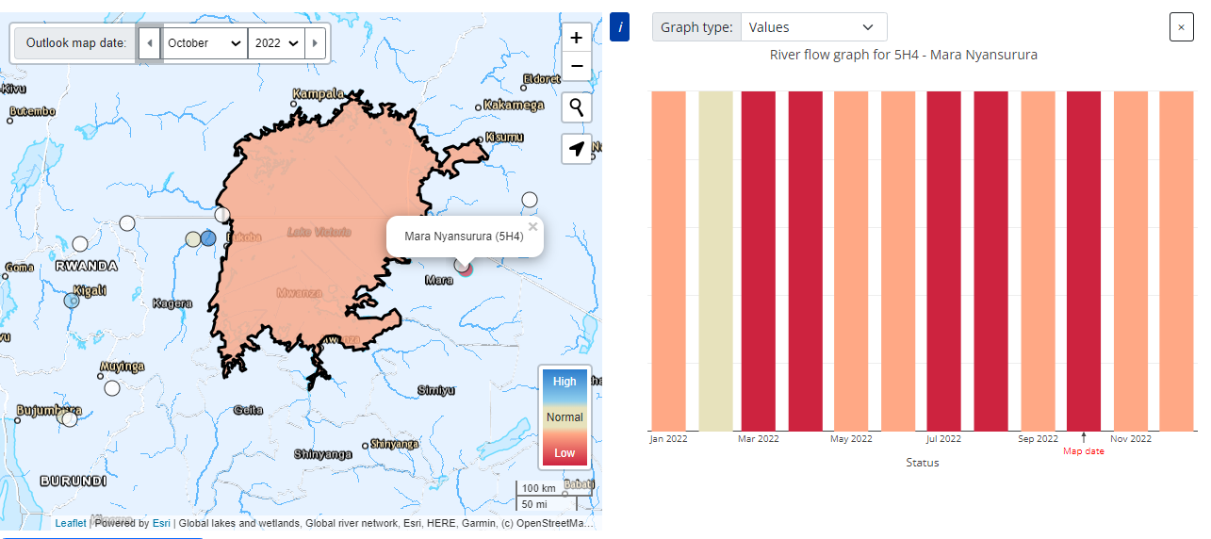
On going work: HydroSOS Portal Rebuild
Live status data integration
https://wmohydrosos.ceh.ac.uk/
Global indicators tested – operational integration in progress
Lake Victoria Basin Demonstrator
Global scale data products (SMHI World Wide HYPE, GloFAS) on schedule for operational integration in June
Notes:
The technical team have produced an R script that can perform these calculations at the click of a button. We are working on developing this in other programming languages, with the aim of providing a toolkit that HydroSOS partners can use to calculate status, and in future outlooks operationally

Slide 9
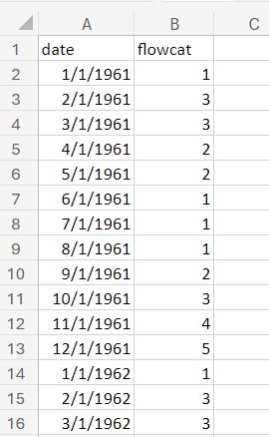
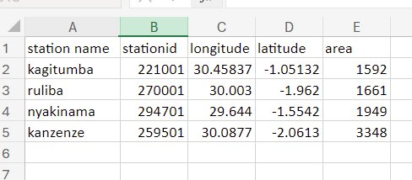
On going: Information Transfer Set ups
APIs are much welcomed (as used in the Czech example)
WHOS will support the data transfer and formatting issues
Still drawing up guidance, but provisional plans are for:
Csv timeseries data for point based products: Date column and category column
JSON data for polygon- and point-based products (for map display)
GEOTIFF data for raster-based products
Monthly data as a minimum, daily data can also be presented
Metadata on station location is also needed
Notes:
The technical team have produced an R script that can perform these calculations at the click of a button. We are working on developing this in other programming languages, with the aim of providing a toolkit that HydroSOS partners can use to calculate status, and in future outlooks operationally
Follow up role of WHOS for Data to Indicators with Washington.

Slide 10
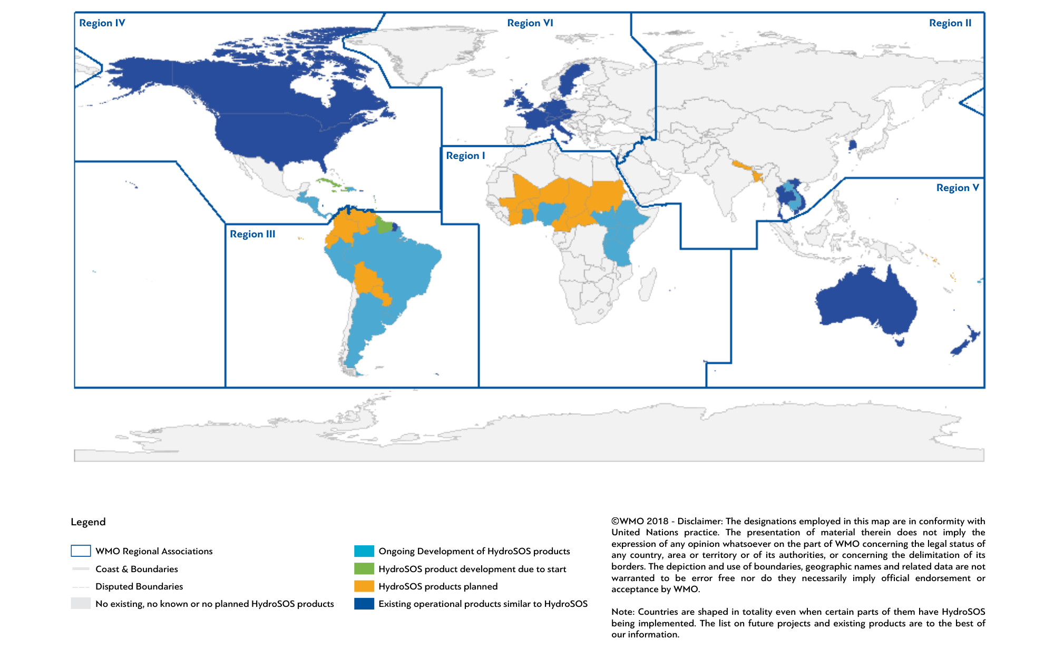
 | 10
Notes:
Status of HydroSOS implementation

Slide 11
Thank you

